Slide 1

AI-Powered Interactive Learning Assistant for Classrooms
By Team Chimera
K. Vignan Uttej
D. Sai Prabhath
N. Sai Shivamani

Slide 2
Project Objective
This project is dedicated to creating an advanced, real-time AI assistant specifically designed for educational environments. Its primary goal is to leverage sophisticated Natural Language Processing (NLP) capabilities to process and respond to student questions submitted through text. By offering immediate, accurate, and contextually relevant answers, the assistant seeks to revolutionize the traditional classroom dynamic. This initiative aims not only to significantly enhance student engagement and comprehension by reducing learning friction but also to provide a continuously supportive and interactive learning ecosystem. Ultimately, it endeavors to free up educators to focus on more complex pedagogical tasks, transforming classrooms into dynamic hubs of personalized discovery and exploration.

Slide 3
Addressing Classroom Challenges
Real-time Doubt Resolution
Scalable AI Support
Current classroom settings often lack immediate systems to address student queries, leading to accumulated doubts and reduced comprehension.
There is a critical need for AI systems capable of instantly supporting a diverse range of student questions without overwhelming human educators.

Slide 4
Key Features of the Assistant
1
2
Text-Only Interaction
Real-Time NLP
Simplifies usage with intuitive text input and clear, concise text-based responses.
Leverages advanced transformer models for instant natural language processing and accurate answers.
3
4
Optimized Performance
User-Friendly Interface
Achieves high-speed model execution with OpenVINO, ensuring minimal latency.
Developed with Streamlit for an accessible and easy-to-navigate user experience.

Slide 5

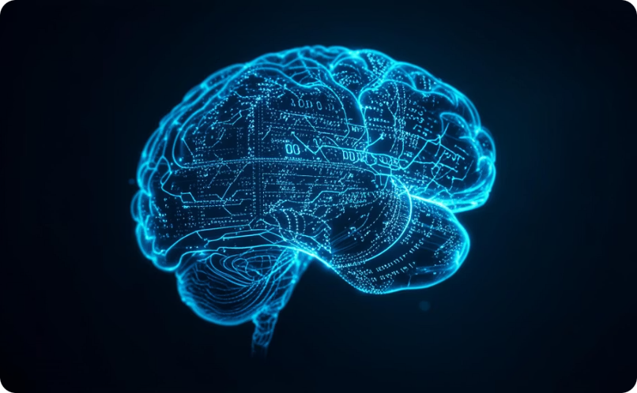


Architecture Overview
The AI-powered learning assistant is built on a robust architecture designed for seamless, real-time text-based interaction and efficient performance. Key components work together to deliver an intelligent and responsive experience:
User Interface (Streamlit)
Natural Language Processing Core
OpenVINO Optimization
Data Integration & Retrieval
A simple, intuitive text-only interface built with Streamlit ensures easy student interaction.
Leverages advanced transformer models to accurately interpret and respond to diverse student queries.
Integrated with OpenVINO for high-speed model execution, significantly reducing latency and ensuring real-time responses.
Connects to a comprehensive knowledge base to pull relevant information and generate accurate, contextual answers.

Slide 6

Operational Workflow
User Question Input
Students type their questions into the intuitive web interface.
Tokenization & Preprocessing
The input text is converted into numerical tokens and preprocessed for the NLP model.
Model Inference (OpenVINO)
The optimized transformer model processes the query at high speed using OpenVINO.
Postprocessing
Model outputs are refined and formatted into human-readable answers.
Response Display
The final, concise answer is shown to the student on the Streamlit UI.

Slide 7

Key Tools and Libraries
The development of the AI-powered learning assistant relies on a robust set of modern libraries and frameworks:
OpenVINO: Optimized inference on Intel hardware.
Transformers: State-of-the-art NLP models.
OpenVINO-dev: Developer tools for model deployment.
Optimum, Optimum-Intel: Performance optimization for Intel chips.
OpenVINO-tokenizers: Efficient text tokenization.
ONNX, ONNX Runtime: Model interchange and efficient execution.
NNCF: Neural Network Compression Framework for optimization.
SentencePiece: Subword tokenization for various languages.
NumPy: Numerical computing foundation.
Streamlit: Rapid web application development.

Slide 8
Model Optimization with OpenVINO
Conversion to ONNX
Why OpenVINO?
Transformer models were first converted to the Open Neural Network Exchange (ONNX) format for cross-platform compatibility and optimization.
OpenVINO was chosen for its ability to significantly accelerate deep learning inference and ensure compatibility across various edge devices.
Deployment with OpenVINO Runtime
NNCF Application
The optimized models are then deployed using the OpenVINO runtime, delivering substantial performance gains and reducing inference latency by up to 2-3x compared to unoptimized models.
The Neural Network Compression Framework (NNCF) was applied to the models, enabling techniques like quantization and sparsity for improved efficiency.

Slide 9
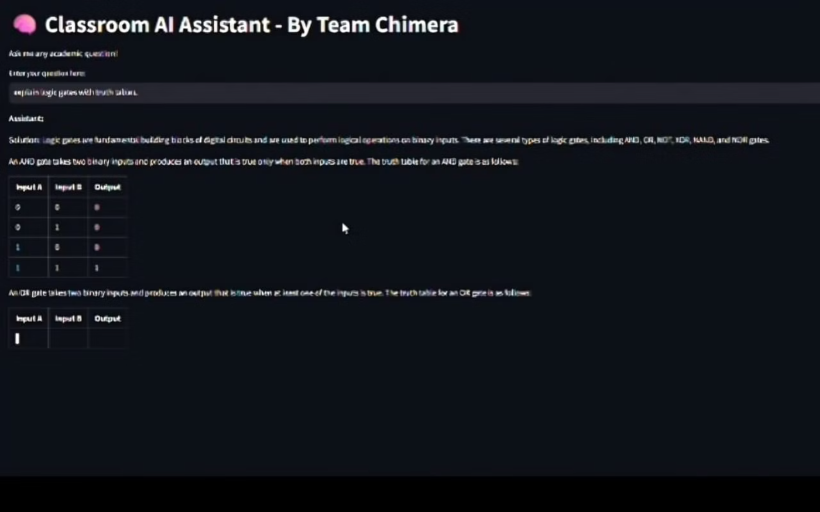
User Interface and Interaction
The AI Learning Assistant features a clean and intuitive web interface built with Streamlit, ensuring a seamless user experience. Students simply type their questions into a designated input box, and the system provides real-time responses.
The design emphasizes simplicity and accessibility, making it easy for students of all tech proficiencies to engage with the tool. The question-response loop is designed to be quick and efficient, mimicking a natural conversation flow.

Slide 10



Conclusion and Future Scope
This project successfully developed an efficient, real-time text-based AI assistant for classroom environments, demonstrating the potential of AI to revolutionize student support.
Multilingual Support
Enhanced Context Retention
Offline Deployment
Expand capabilities to support multiple languages, catering to diverse student populations.
Explore options for deploying the assistant in environments without consistent internet access.
Improve the AI's ability to maintain context across multiple turns for more coherent conversations.

